Slide 1
templates

Slide 2
AnAlysis output template
Hypothesis
Analysis Foundation
Analysis Results
Background
Key Results
Business Questions
Potential Business Actions
Breakdown of Demand_eV in business cases into daily targets per brand and per country using overall average
Stakeholders involved
Filters used
Online channels: Paid Search, Organic Search, Direct
Sessions with over 2 Page Views
Key Analysts
Stakeholders

Slide 3
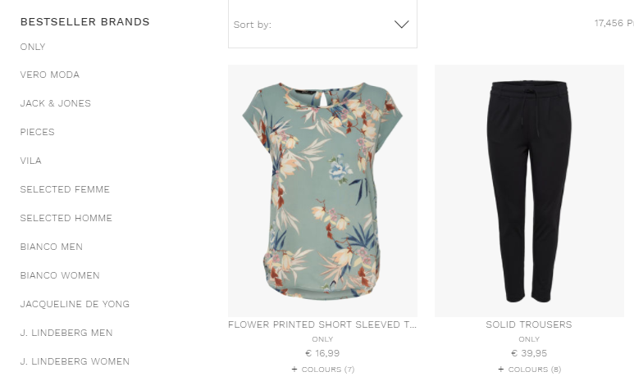
1. What?
Current traffic situation
All components of customer journey should be tracked.
2 main issues in current situation:
Incorrect data (tracking with incorrect labels or same events with different labels accross storefronts)
Missing data (not tracking the data at all)
There are 2 distinct types of “hits” (session components) which will influence the business in a different way:
Events – Interaction of the user with the website (clicks, open of menus, scroll down, etc)
Pages – What the consumer sees in the website (page types, products, page origin, etc)

Slide 4
2. Why?
Why is it important to tackle the issues upcoming from the current situation?
Current analysis might bring to wrong conclusions – incorrect data (events labeled incorrectly, no documentation leads “self-documentation”)
Some events/KPIs/session components cannot be analyzed – missing data
Adopt a solid and homogenous approach leads to organization – processes can run smoothly + short, medium and long term gains
More and better data – more mechanisms to investigate and support decisions
Gain trust in data – solid and more confident decision making processes
Maximize performance of our product, the websites – is there where customers go and is there the customer’s first impression of the brands

Slide 5
3. How?
How can we change current status?
First steps
Document existing processes
Easier to read/check/analyze
Easier for new commers (future)
Easier implementations – due to organized working flow
Create and document non-existing processes
(same as above)
Explore new implementations easily and in deeper detail
New traffic KPIs can be created
(see excel file as example)

Slide 6
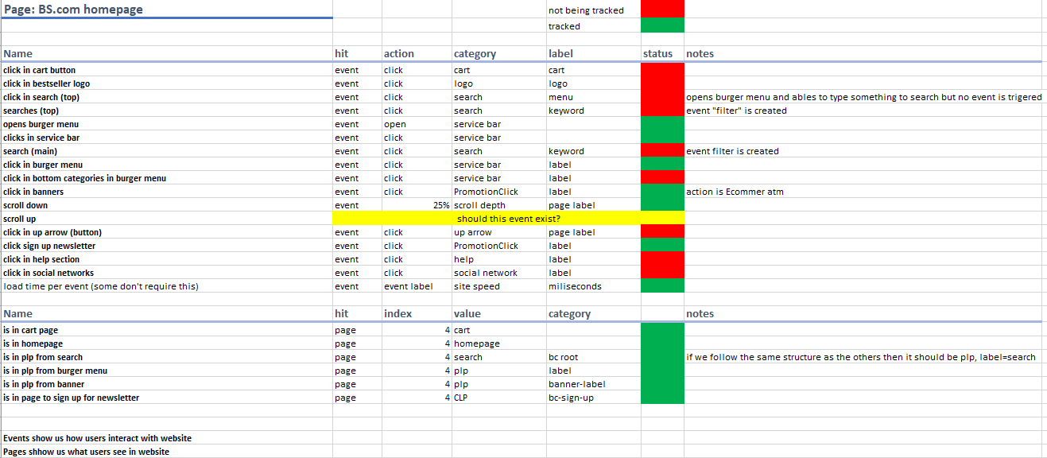
3. How?
How can we change current status?

Slide 7
4. When?
When shall this situation be tackled?
The sooner the better
The sooner we start tracking data correctly the more data we will have in the future
Low investment
Not much time is spent in the short term
In the medium/long term time is saved
Implementations done easily
No time spent on searching (both for analysis as well as for other procedures that require understand the tracking process)
Analysis will be more trustworthy, deeper level of detail and done faster

Slide 8
5. Future?
Better, more detailed and trustful source of data
How would the future situation look like
Analysis with deeper level of detail allow us to tackle the issues faster and right in the source
Website performance can be done based on customer journey – optimize user experience should be the main goal
Currently not many analysis were made but 2 of the quarter goals came from those analysis. All those problems can be found and tackled.
More traffic data, new KPIs
No big investment → big gains
Examples:
…

Slide 9
6. Vision
Bestseller
Proactive approach
Take actions + be able to make decisions based on:
Knowledge
Trust
Data

